Slide 1
EXPENSE CLAIM MODULE
Group 4 Oct-04-2019

Slide 2
CONTENTS
S.no. | Topics
1 | Module Introduction
2 | Functionalities
3 | Claim an Expense
4 | View All Expense Claimed
5 | View Expense Claimed by Id
6 | Update Expense
7 | Delete Expense by Id
8 | Testing and Logger
9 | Deployment on Cloud(AWS)

Slide 3
MODULE INTRODUCTION
This module aims to integrate all the micro services, i.e. Employee Code Module, Project Code Module and Expense Code Module.
The module receives employee , project and expense details from respective microservices.
A portal is created using an angular webpage through which a user can claim, view, update and delete the expense.

Slide 4
FUCTIONALITIES
Claim An Expense
View All Expense Claims
View Expense Claim By Id
Update An Expense Claim
Delete An Expense Claim By Id

Slide 5
CLAIM AN EXPENSE
In this functionality user will choose the Employee Id, Expense Code Id, Project Code Id from drop-down menu.
If valid, the corresponding details will be fetched from Employee Code Module and displayed else , the error message will be displayed and the user will not be able to proceed further.
User will enter start date , end date, Expense Amount.
After validation is done on comparing dates, the values will be stored into the database.
The Expense Claim Id will be auto-generated.

Slide 6
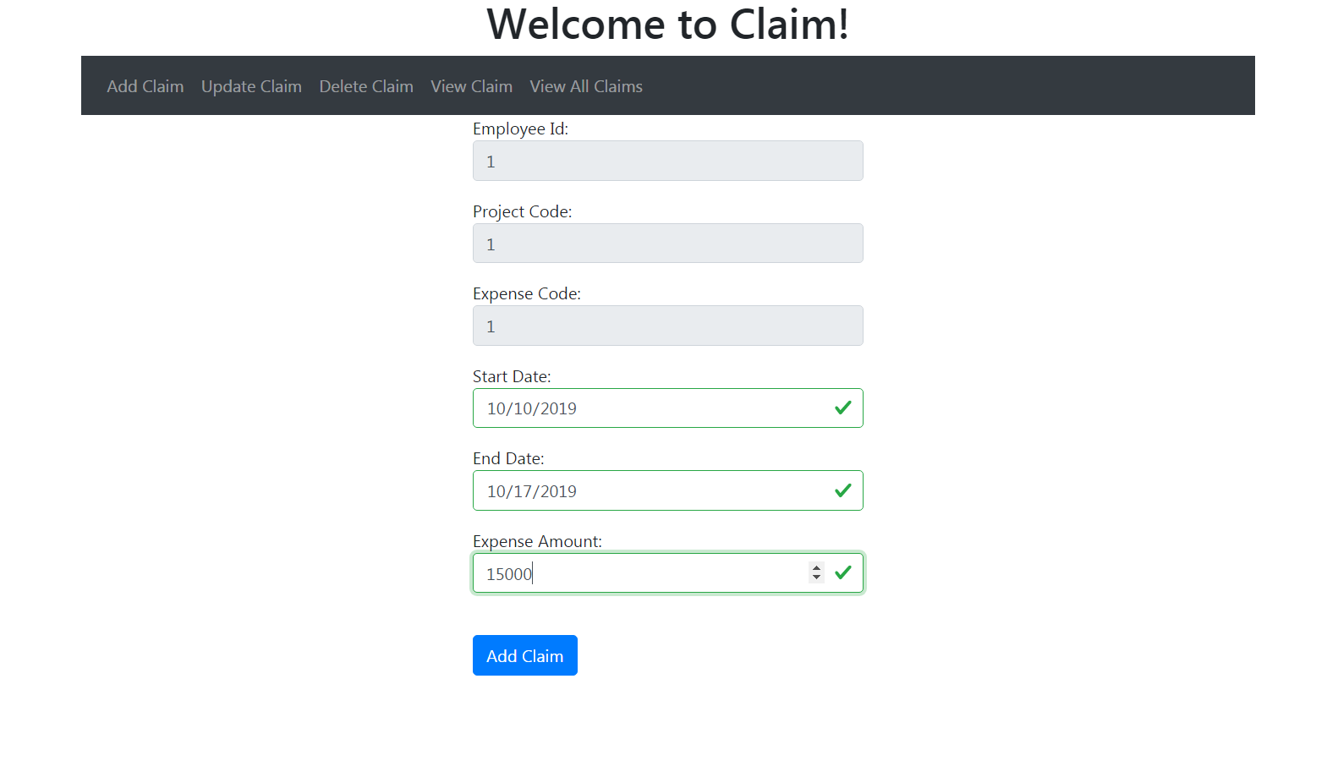

Slide 7
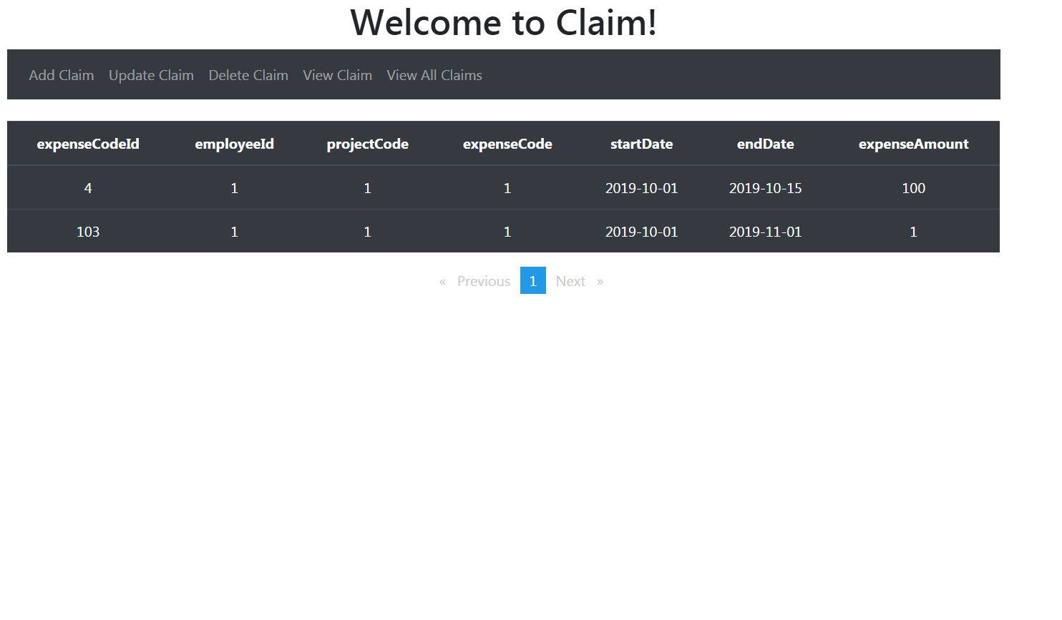
VIEW ALL EXPENSE CLAIMS
Using this functionality the user can view all the expense claims.

Slide 8
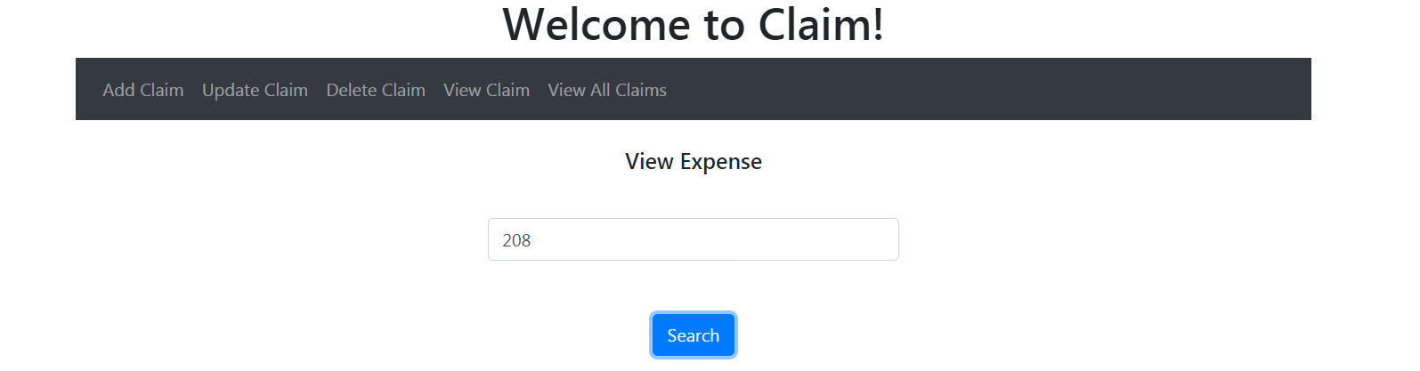
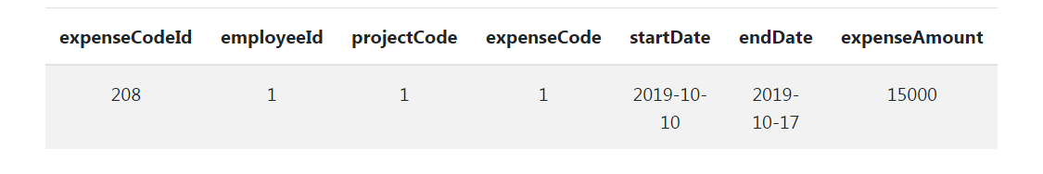
VIEW EXPENSE CLAIM BY ID
This functionality allows the user to search an Expense claim using an ID. If entered ID is valid, the details will be displayed, else if the ID is invalid, the error message will be displayed on the screen.

Slide 9
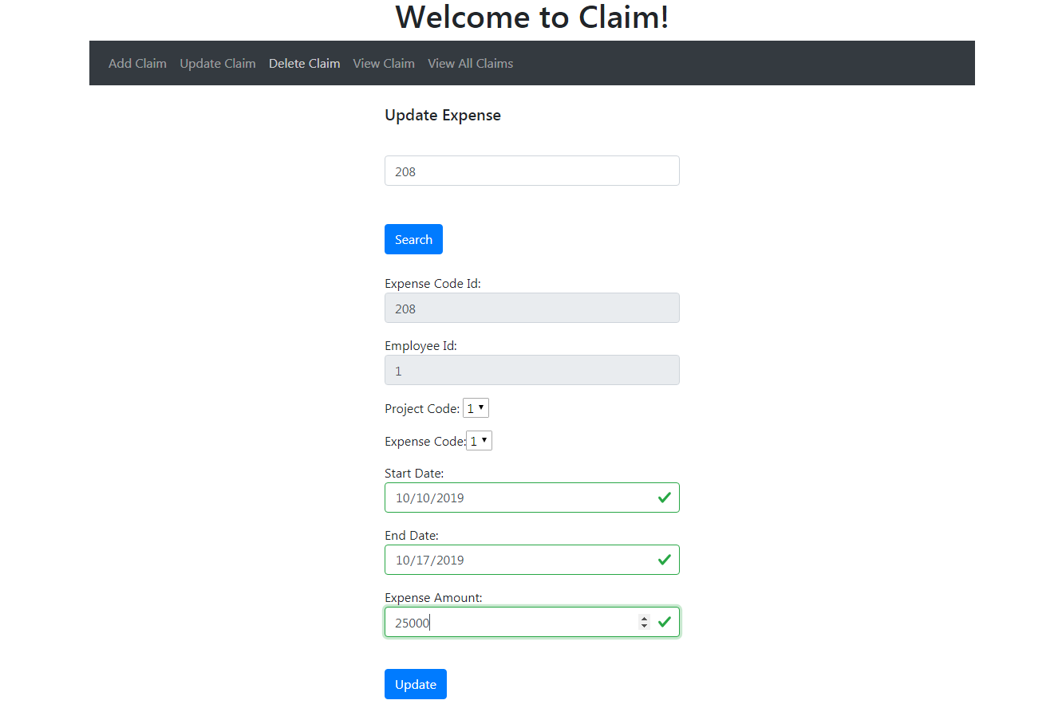
UPDATE AN EXPENSE CLAIM
In this functionality the user is required to enter the Expense Code ID. If entered ID is valid, the details will be displayed and user will be able to modify the details wherever required. Else if the ID is wrong, the error message will be displayed on the screen.

Slide 10
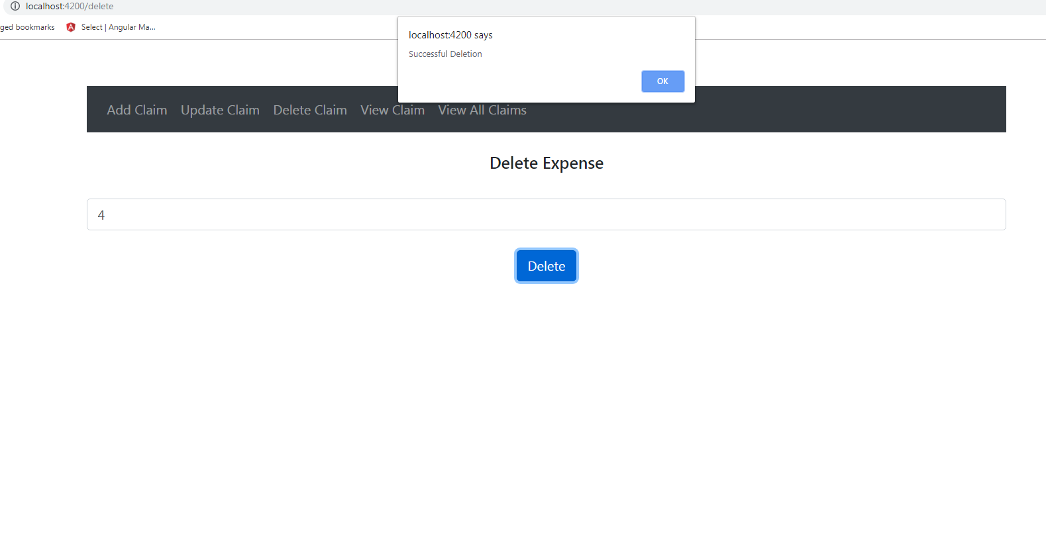
DELETE AN EXPENSE CLAIM
This functionality allows the user to delete an Expense claim using an ID. If entered ID is valid, the details will be deleted, else if the ID is invalid, the error message will be displayed on the screen.

Slide 11
Testing and Logger
In this module we have implemented Mockito Testing framework . In which we have tested both the “Behavior Verification” as well as the “Verify Interaction”.
To add a behavior to the mocked class when() and thenReturn() functions are used. Mockito verify() method checks that a method is called with the right parameters.
Logger is implemented using log4j. Logging is used to store exceptions, information, and warnings as messages that occur during the execution of a program. It helps a programmer in the debugging process of a program.

Slide 12
Deployment On Cloud(AWS)
We have created EC2 Amazon Linux instance.
Jar files were imported from spring boot application.
Then we have created a docker file to convert the jar files into docker images.
Docker image will create the environment for mariadb.
We are using adminer to interact with the database.

Slide 13
Thank You !

